Slide 1

Operations Team Meeting
Version 1
Production & Engineering
From : Debarshi Ray
Date : March 10, 2025
Sr. Number : CORP/PRD/DR/20250310/01

Slide 2
Production AFC : CY projection & FY26 proposal
All figures in Rs. Lakhs
Account heads | PY | CY |  |  | AOP Proposal FY26
 |  | AOP | YTD (Feb) | Projection FY25
R2M+R2O | 57,03 | 44,36 | 45,02 | 48,92 | 51,78
Utilities | 38,35 | 37,71 | 34,47 | 37,61 | 39,60
Building maintenance | 11,95 | 12,24 | 11,33 | 12,59 | 13,24
Insurance | 6,84 | 6,80 | 5,54 | 6,04 | 8,59
Rates & Taxes | 5,67 | 5,21 | 5,34 | 5,79 | 5,74
Others | 11,47 | 9,72 | 9,74 | 10,47 | 10,68
Total | 131,31 | 116,04 | 111,44 | 121,18 | 129,63
Commercial printing revenue | -12,55 | -16,66 | -13,90 | -15,40 | -16,10
Grand total | 118,76 | 99,38 | 97,54 | 105,78 | 113,53
FY25 Projection : 11% reduction from PY actuals and 6% exceed from AOP
FY26 AOP is proposed to increase by 7% from projection of FY25
Excluding Software expenses
Data Source : Finance Ledger and Plant MIS

Slide 3
AFC FY26 Proposal : Plant and cost head wise
All figures in Rs. Lakhs
Cost Head / Plant | SAH | KND | AIR | CHE | BAN | PUN | KOL | MSR | HYD | LUC | MUM | NGP | AHM | CHA | TRI | COC | BAR | Total
Repairs - Machinery | 13,25 | 8,65 | 4,99 | 4,03 | 7,18 | 2,55 | 4,42 | 1,93 | 84 | 67 | - | 20 | 78 | 10 | 16 | 26 | 15 | 50,17
Utilities | 9,20 | 6,50 | 6,44 | 2,93 | 4,07 | 2,58 | 2,95 | 1,38 | 1,03 | 94 | - | 53 | 81 | - | - | - | 24 | 39,60
Maintenance | 2,01 | 1,55 | 1,49 | 1,40 | 2,07 | 83 | 1,44 | 58 | 81 | 30 | - | 23 | 27 | - | 15 | - | 11 | 13,24
Insurance | 1,82 | 1,45 | 1,70 | 57 | 91 | 50 | 63 | 26 | 21 | 15 | - | 9 | 16 | 8 |  | - | 6 | 8,59
Rates & taxes | 70 | 1,80 | 1,89 | 13 | 21 | 19 | 48 | 2 | 9 | 10 | - | 3 | 8 | - | - | - | 3 | 5,74
Travelling | 22 | 40 | 3 | 37 | 1,38 | 5 | 5 | 3 | 2 | 2 | 66 | 1 | 15 | - | 1 | 1 | 18 | 3,57
Repairs - Buildings | 1,15 | 60 | 48 | 9 | 17 | 15 | 20 | 12 | 17 | 8 | - | 2 | 15 | 3 | - |  | 8 | 3,48
Repairs - Others | 26 | 35 | 11 | 14 | 8 | 12 |  | 5 | 13 | 8 | 1 | 7 | 13 | - | 2 | 2 | 5 | 1,61
Consultancy | 5 | 5 | - | - | - | 4 | - | 1 | 3 | 5 | 45 | 9 | 1 | - | - | - | - | 77
Cartage & Coolie | 19 | 2 | 14 | - | - | - | - | 9 | 2 | 20 | - | - | - | - | - | - | 1 | 68
Training & Conferences | - | 50 | - | - | - | - | - | - | - | - | - | - | - | - | - | - | - | 50
Others | 2 | 2 | - | - | - | 2 | - | - | - | - | 12 | - | 4 | 16 | - | 1 | - | 39
Freight / Cartage on Newsprint | - | 2 | - | - | - | 34 | - | - | - | - | - | - | - | - | - | - | - | 36
Communication | 10 | 2 | - | 1 | 2 | 1 | 3 | 2 | 2 | 1 | - | - | 1 | - | - | - | - | 25
Printing & Stationery | 10 | 3 | 1 | - | 1 | 1 | 2 | 2 | - | - | - | - | 1 | 0 | - |  | - | 22
Recruitment expenses | 16 | - | - | - | - | - | - | 5 | - | - | - | - | - | - | - | - | - | 21
Rent | - | - | - | - | - | - | - | - | - | - | - | - | 14 | - | - | - | - | 14
Periodicals | 2 | - | - | - | - | - | - | - | - | - | - | - | - | - | - | - | - | 4
Audit Fees | - | - | - | - | - | - | - | - | - | 2 | - | 1 | - | - | - | - | - | 3
Publicity & Promotions | - | 3 | - | - | - | - | - | - | - | - | - | - | - | - | - | - | - | 3
Distribution Expenses(Rail/Road) | - | - | 1 | - | - | - | - | - | - | - | - | - | - | - | - | - | - | 1
Outside work charges | - | 1 | - | - | - | - | - | - | - | - | - | - | - | - | - | - | - | 1
Legal Charges | - | - | - | - | - | - | - | - |  | - | - | - | - | - | - | - | - | -
Total | 29,24 | 22,00 | 17,28 | 9,68 | 16,11 | 7,37 | 10,22 | 4,54 | 3,38 | 2,63 | 1,25 | 1,29 | 2,73 | 38 | 34 | 30 | 90 | 129,63
Commercial printing revenue | - | -81 | -30 | - | -8,65 | -8 | -3,70 | - | - | - | - | - | -1,50 | - | - | - | -1,06 | -16,10
Grand Total | 29,24 | 21,19 | 16,98 | 9,68 | 7,46 | 7,29 | 6,52 | 4,54 | 3,38 | 2,63 | 1,25 | 1,29 | 1,23 | 38 | 34 | 30 | -16 | 113,53
Excluding Software expenses

Slide 4
CapEx Proposal : FY26
All figures in Rs. Cr
# | Description | Proposal FY26 | Approved | Execution plan | Cash Flow FY27
 |  |  |  | FY26 | FY27
1 | Airoli Colorman A Electronic Upgrade | 52.0 | 52.0 | 13.0 | 39.0
2 | CTP Replacement 3 Lines (Knd, Pun & Ahm) | 8.0 | 8.0 | 8.0 | -
3 | Mail Room Upgrade - Multiple Locations | 17.4 |  | 15.5 | 1.9
4 | Fire and Safety - Multiple Locations | 4.0 |  | 4.0 | -
5 | Network and Server Upgrade – Pan India | 4.0 |  | 4.0 | -
6 | Airoli Roof Repair | 3.9 |  | 3.0 | 0.9
7 | Miscellaneous | 2.8 |  | 2.5 | 0.3
Total | Total | 92.1 | 60.0 | 50.0 | 42.1
Other items with low priority | Priority 2-4 items | 27.2
Grand total | Grand Toal | 119.3

Slide 5
CapEx & Cash flow : FY25
All figures in Rs. Lakhs
Project | Status | Approval |  | PO | Spent till FY24 | FY25
 |  | Year | Amount | Value |  | Spent till Feb25 | March | Total
Electronic Upgrade Colorman KND & SBD Lot 1 | Under Execution | FY22 | 700 | 60,10 | 30,97 | 6,46 | 7,68 | 14,14
Electronic Upgrade Colorman KND & SBD Lot 2 | Under Execution | FY22 | 70,00 | 57,31 | 15,88 | 12,51 | 3,00 | 15,51
Electronic Upgrade Regioman Kolkata Lot 3 | Under Execution | FY23 | 19,75 | 22,50 | 87 | 3,82 | - | 3,82
Electronic Upgrade Colorman B Airoli Lot 3 | Under Execution | FY23 | 39,00 | 35,00 | - | 1,51 | - | 1,51
Digitization & Archival MT Mum Edition | Under Execution | FY24 | 2,50 | 1,69 | 36 | 74 | 76 | 1,50
Digitization & Archival of EiSamay | Under Execution | FY24 | 18 | 10 | 10 | 12 | - | 12
PDF Workflow ( Two Projects to split) | Under Execution | FY24 | 1,25 | 1,21 | - | 96 | 7 | 1,03
Roof repair & strengthening : Chennai Plant | Under Execution | FY25 | 2,50 | 2,15 | - | 93 | - | 93
Replacement of CTPs at Blr, Sbd, Air & Che | Che & Air received | FY25 | 10,00 | 9,93 | - | 4,37 | 5,56 | 9,93
Retrofit of emission control devise for DG - across plants | PO Placed | FY25 | 12,80 | 3,27 | - | - | 2,88 | 2,88
Upgradation of UV curing system - Knd & Air | PO Placed | FY25 | 18,00 | 11,58 | - | - | - | -
ETP / STP Separation at Pune | PO Placed | FY25 | 41 |  | - | - | - | -
UPS Replacement at Bengaluru | PO Placed | FY25 | 45 | 41 | - | - | 20 | 20
Chiller Replacement at Sahibabad | BOQ Shared | FY25 | 2,50 |  | - | - | - | -
New Press at Hyderabad | PO Placed | FY25 | 29,00 | 22,14 | - | - | - | -
Replacement of Chd Press with refurbished Kandivali Hiline | BOQ Shared | FY25 | 6,00 |  | - | - | - | -
Total |  |  |  |  | 48,18 | 31,42 | 20,35 | 51,77

Slide 6
Manpower : FY25 & FY26 projection
FY25 _{ytd Feb} Status
FY25 _{ytd Oct} Summary
Cost in Rs Lakh
20
10
15
19
vs FY19
Resignation
Retirement
Transfer to P&T
Recruitment
-5%
9 GET
vs FY19
-28%
FY26 Projection
FY25 _{ytd Oct} Summary
Exit : 9 nos
Vacancies : 9 nos
Nos
Retirement : 9
Prepress : 5
Printing : 3
AI development : 1
FY 25 Manpower nos as on Mar 25
Data source : Staff cost as per Finance ledger

Slide 7
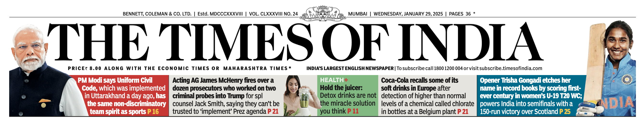

Tracking Newspaper Receipt through QR Code
QR Code for Delivery tracking
QR Code to be introduced in TOI Mumbai and Delhi
Acknowledgment from BCCL users and Outsiders to be tracked separately
Brand team to decide on the landing page and message acknowledgment
Approval to be taken on prototype (incorporating QR code) from COO & CEO before roll out

Slide 8
Mumbai Mirror & NBT Delhi : Brand’s Request
Mumbai Mirror
NBT Delhi
Brand Proposal
Brand Proposal
Print order : 1.0 to 1.6 Lakh
ET PO reduction : 0.90 to 1.5 Lakh
LPR demanded : Midnight
Advance LPRS for all NBT Delhi editions
NBT Editions | Current LPRS
Delhi Mahanagar | 23:00
Noida | 22:45
Ghaziabad | 22:45
Faridabad | 22:00
Gurgaon | 22:00
LPR proposed by production : 23:00
Challenges on midnight LPRs for Mirror
Challenges on advancing LPR
TOI midnight LPR with ~50 Minutes delay
ET midnight LPR with ~30 Minutes delay
Mirror copy flow starts after : 00:30 _{(RMD to confirm)}
Increased complexity with GNP jackets both in TOI & ET
Late Print start of NBT to be confirmed by RMD
Impacts single book delivery (ballooning) for NBT NCR (Ghaziabad / Noida) editions
Impacts the print start of TOI Capital, Noida, and Gurugram editions.

Slide 9
Kandivali : PO, LPR & GNP
# | Details | FY25 | FY20
1 | LPRS | MM 22:45 (Sunday issue) NBT 23:00 MT 23:15 TOI 00:00 ET 00:00 | MM 22:45 NBT 22:30 MT 23:15 TOI 00:00 ET 00:00
2 | Actual LPR | MM 22:44 (Sunday issue) NBT 23:20 MT 23:35 TOI 00:50 ET 00:30 | MM 22:52 NBT 22:34 MT 23:20 TOI 00:40 ET 00:25
3 | Print Order | NBT 0.7L MT 1.9L TOI 5.4L ET 3.1L TOIN 0.1L MTN 0.2L Total 11.4L | MM 4.4L NBT 1.2L MT 2.6L TOI 6.9L ET 1.8L TOIN 0.2L MTN 0.5L Total 17.6L
4 | GNP Jackets (Nos) (Ytd Feb for CY and PY) | TOI 135 ET 81 NBT 11 MT 11 Total 238 | TOI 51 ET 21 NBT 11 MT 11 Total 94
MM on Sunday 2.8L

Slide 10



Highlights for the Month
Indian Express printing from Kolkata : Started from issue dated March 6, 2025
Infra mapping done for Press, CtP & Mailroom
Ahmedabad team secured its first patent for an improved auto-paster, enhancing newspaper print quality with an advanced auto side-lay system.
The "Storyteller" campaign, launched in Wave 17 last year, was successfully executed in TOI on Feb 14, 2025, generating strong revenue.
Long service award to WB employees
Maharashtra Plants: Power tariff concerns

Slide 11
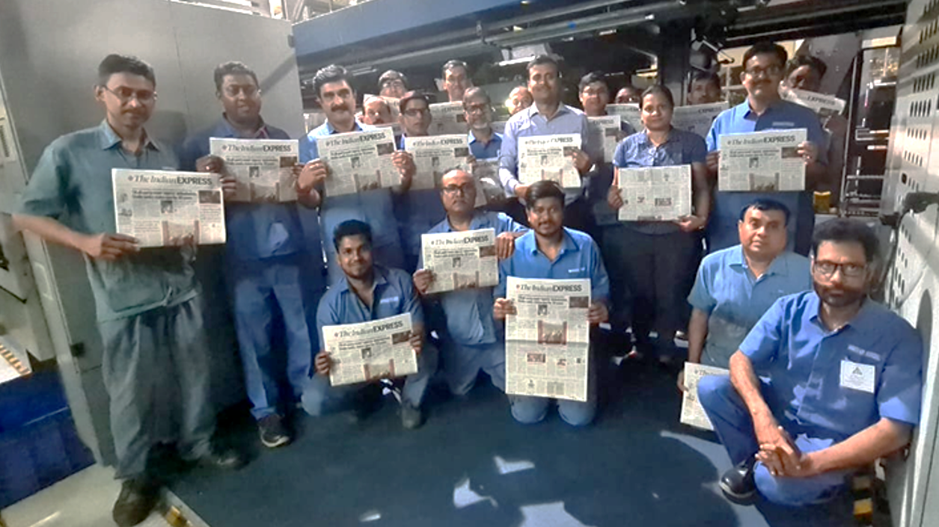
Started Indian Express Printing from Kolkata Press
Indian Express editions printing started from Kolkata plant from 6th March 2025
IE Upcountry
IE Late City
Financial Express,
Jansatta
New milestone to start printing newspaper from other publications

Slide 12
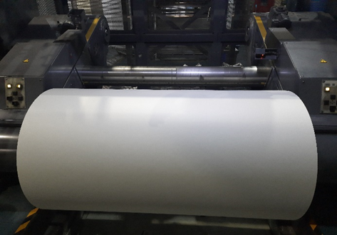
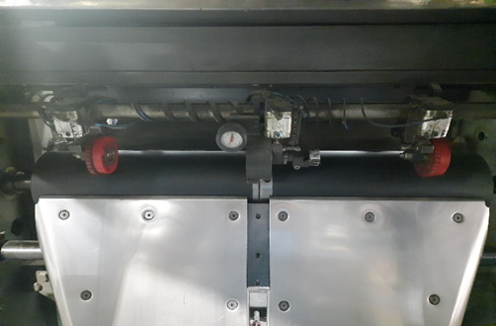
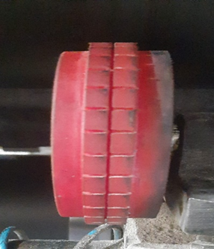
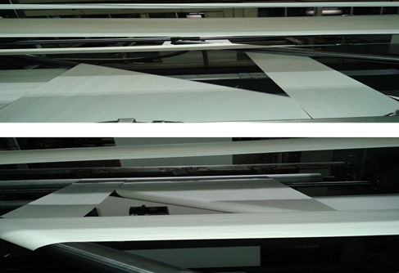
Indian Express Printing : Preparation in CTP & Press
CtP
Press
Former Position
Centre Slitter
Blade 1
Blade 2
Blade 3
Blade 4
Reel Loading in center position for 54’’.
Trolley shifted 5mm closer
Centre trolley width reduced to 8mm to avoid folder mark.
Turner bar special position data taken for auto-control from Console
Pano plate 1
6.50mm white space
Pano plate 2
Incorporated the word Kolkata in template
Reel loading to be done as per different SKUs – 54’’, 40.5’’ & 27’’
Trolley modification in size and position done to avoid “Marks”.
Segregation of reels of different SKU of Indian Express has been done with manual stamping.
Designated area assigned for IE paper wastage.
A New template has been created in CTP Wobe workflow
Cut Con (Cut off) mark shifted as per requirement
“Kolkata” Text added as per request of Indian Express Group.

Slide 13
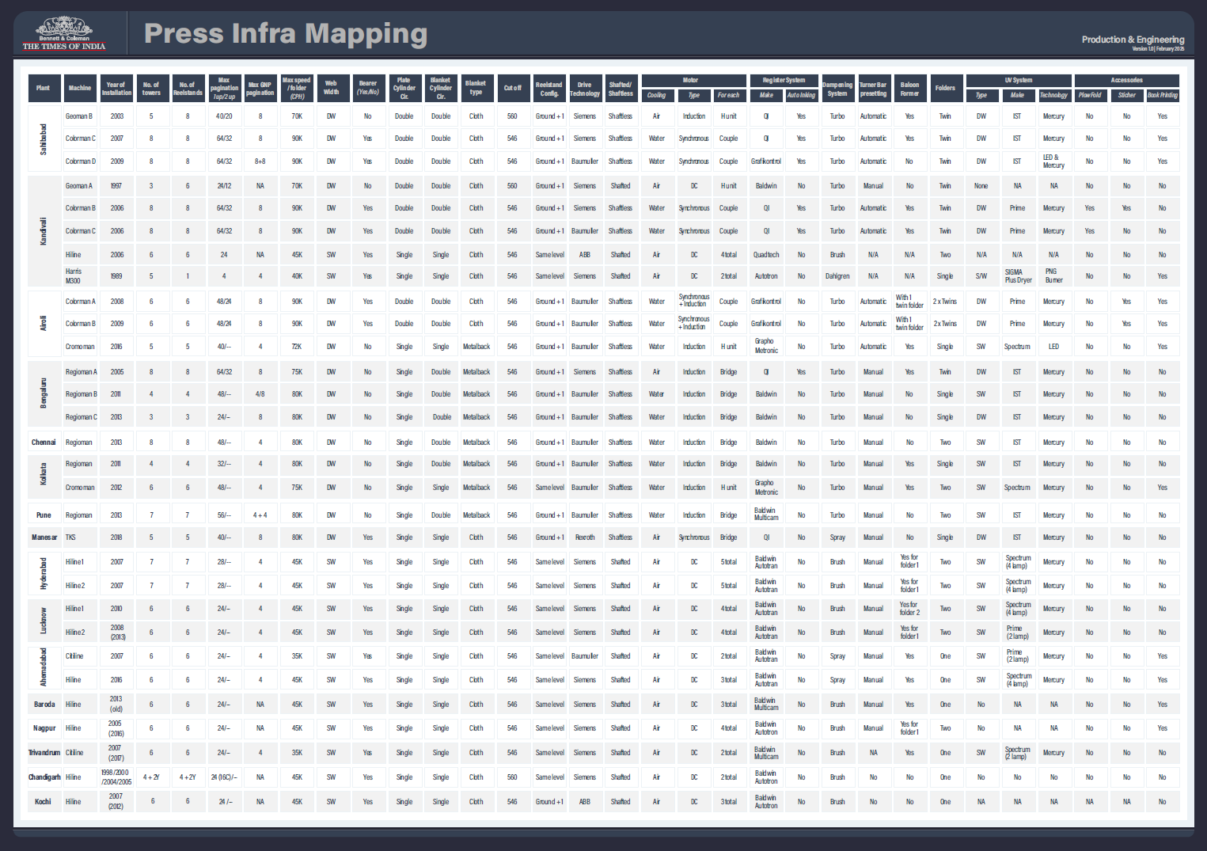
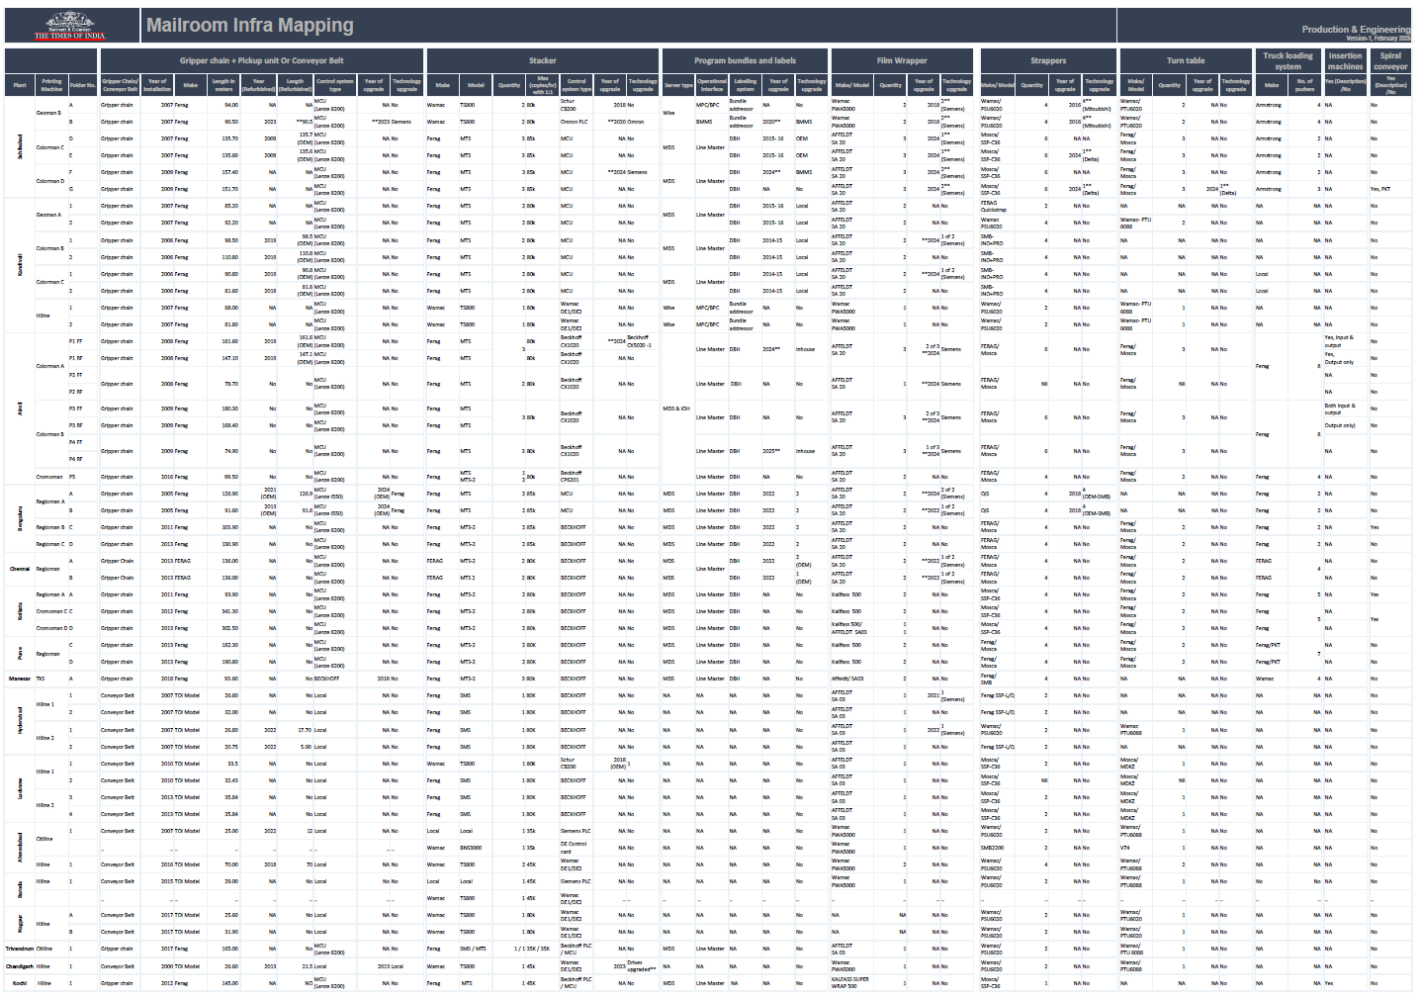
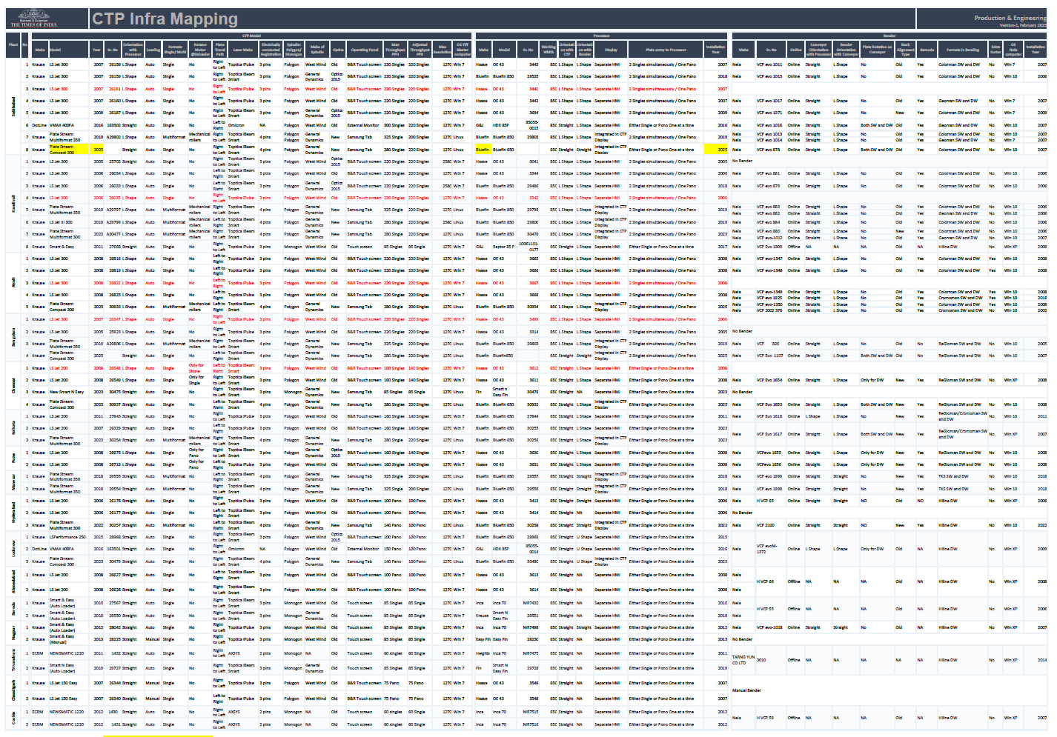
Plant Infra Mapping : Press, CtP & Mailroom
Benefits
Visibility of Pan India infrastructure in single page
Understand the complexity and its variability
Enabling collaboration for technology, spares & skills
Easy to track equipment obsolescence and plan upgrades
Identifying skills required and managing their development plan

Slide 14

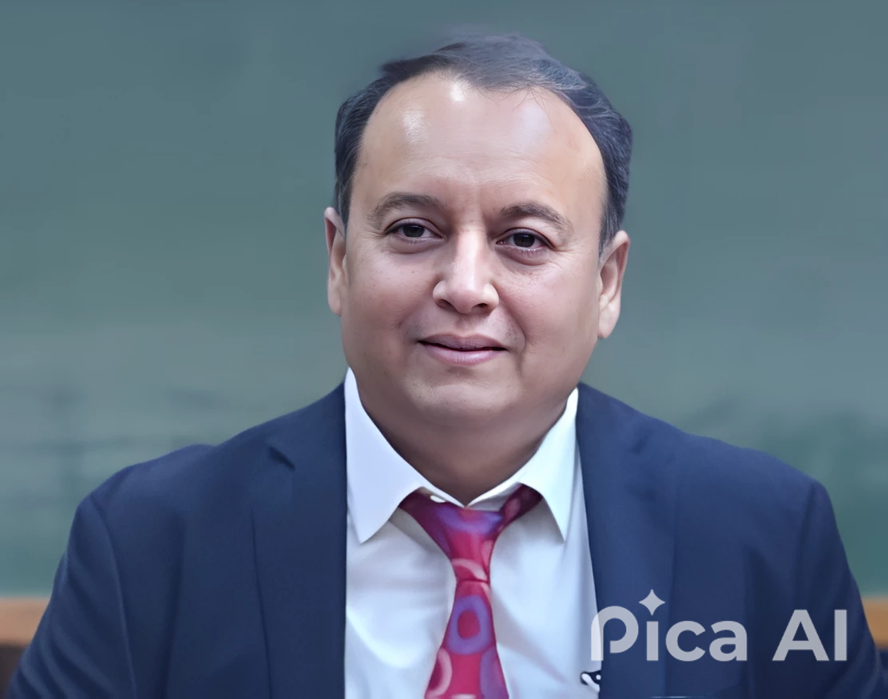
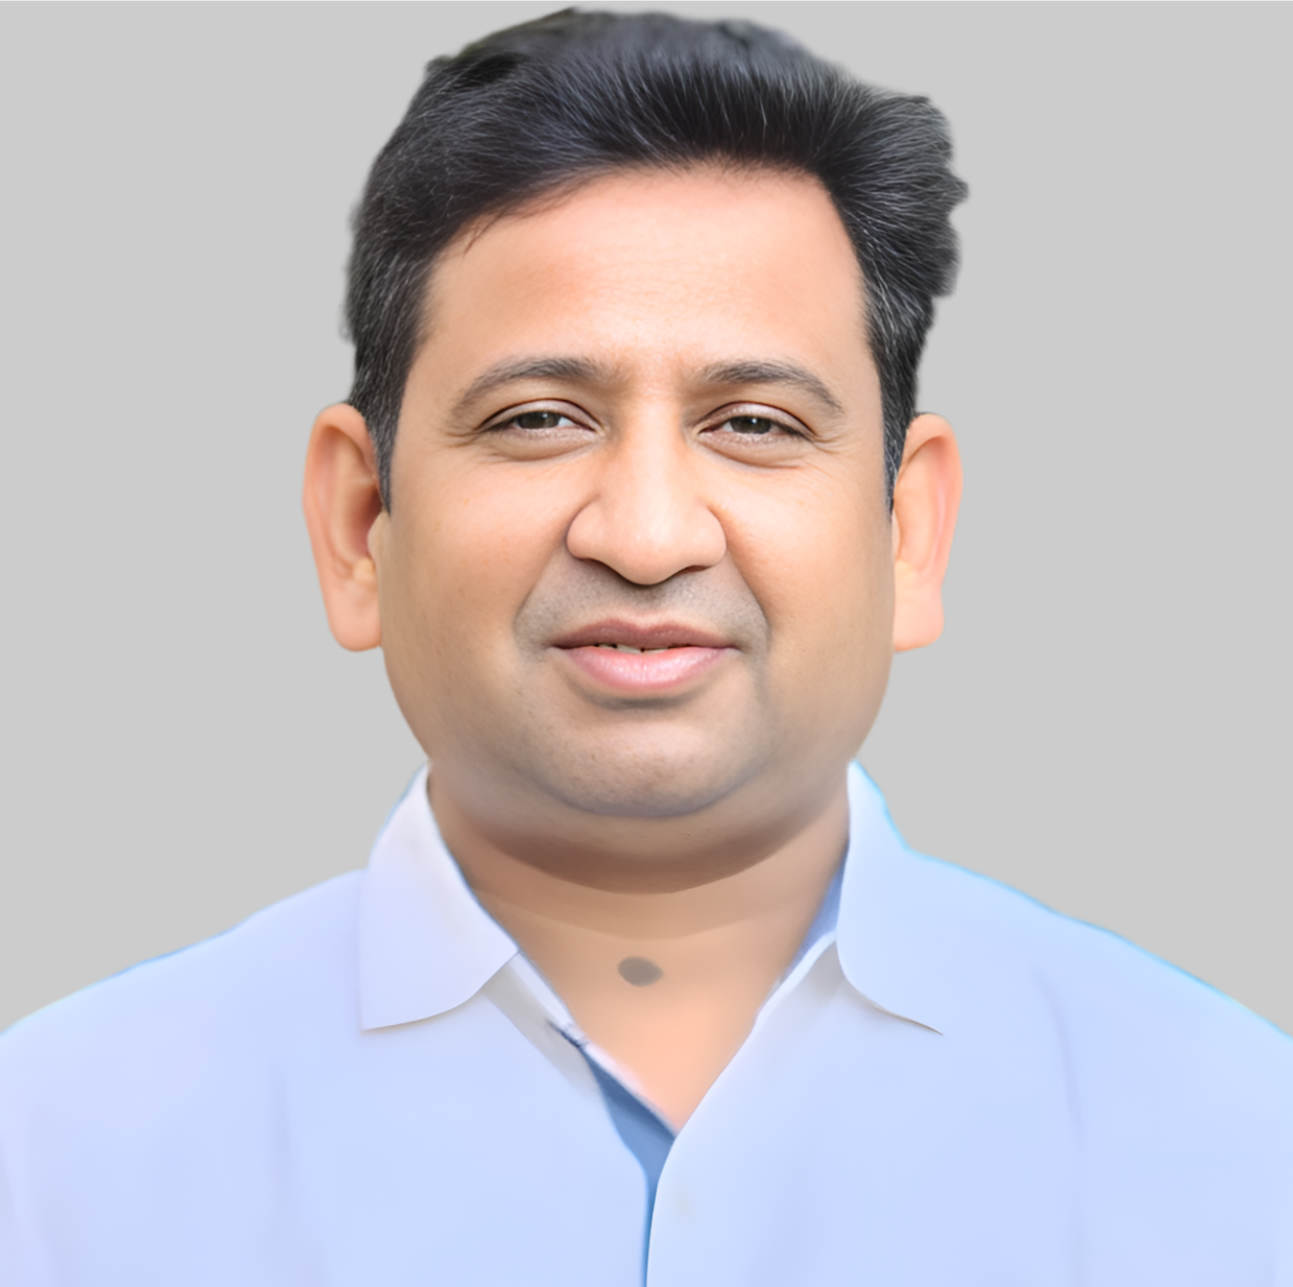
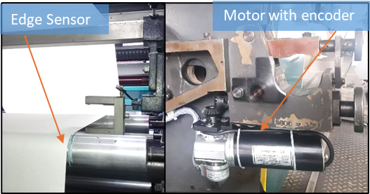
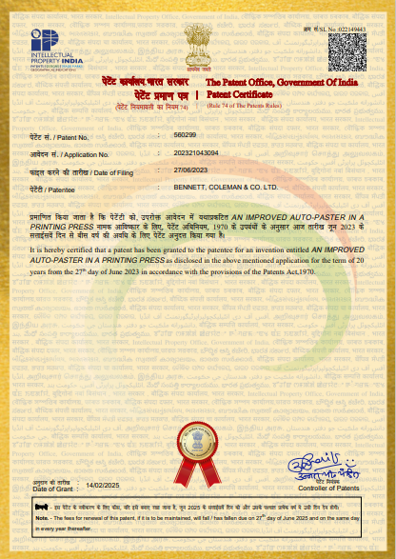
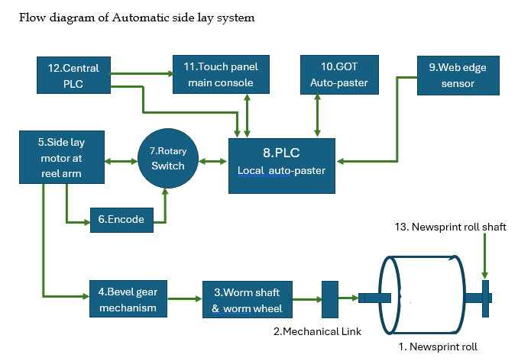
First Patent for Ahmedabad Team
Why we innovated
Team members
The traditional manual side lay adjustments posed challenges such as inconsistent print quality, increased operator labor, and higher non-productive waste.
The need for a fully automated solution arose to address these issues while improving efficiency and reducing operational costs.
Auto side lay system
What we innovated
Pradeep Das
Ramesh Patel
Developed an improved auto-paster in a printing press using PLCs, Edge sensors, and customised software to enable automatic web alignment without human intervention.
The system leverages customized control software to ensure real-time and accurate alignment of the web, without the need of human intervention.
This first-of-its-kind system in the industry is poised to revolutionize web handling in printing machines.
Patent Certificate
Flow diagram
Benefits
No human intervention and reduction in NP waste
Enhanced print quality by consistent web alignment
Pan India potential
Developed system installed at Hyderabad, Lucknow & Baroda plants

Slide 15
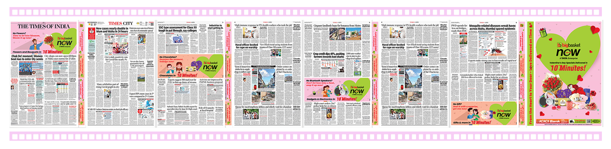
First to Market : Storyteller' Trendsetter _{Offered in Wave-17}
For the first time, Production executed the "Storyteller" trendsetter in TOI ID on February 14th, 2025.
Printing took place across all our in-house plants and OSPs, except Guwahati, where a 2-page jacket was printed due to capacity constraints.
The Production team ensured necessary preparedness and coordinated with the Response team to execute this product seamlessly across locations.

Slide 16

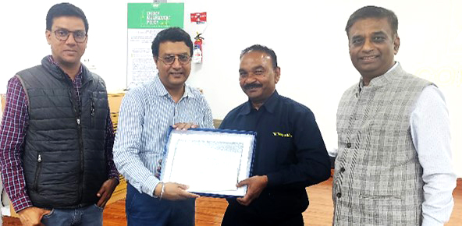
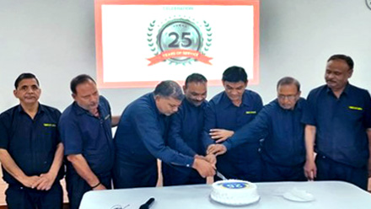

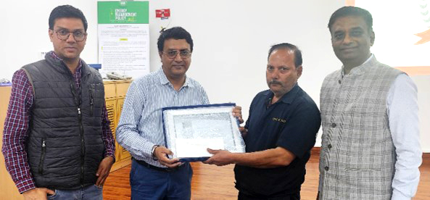
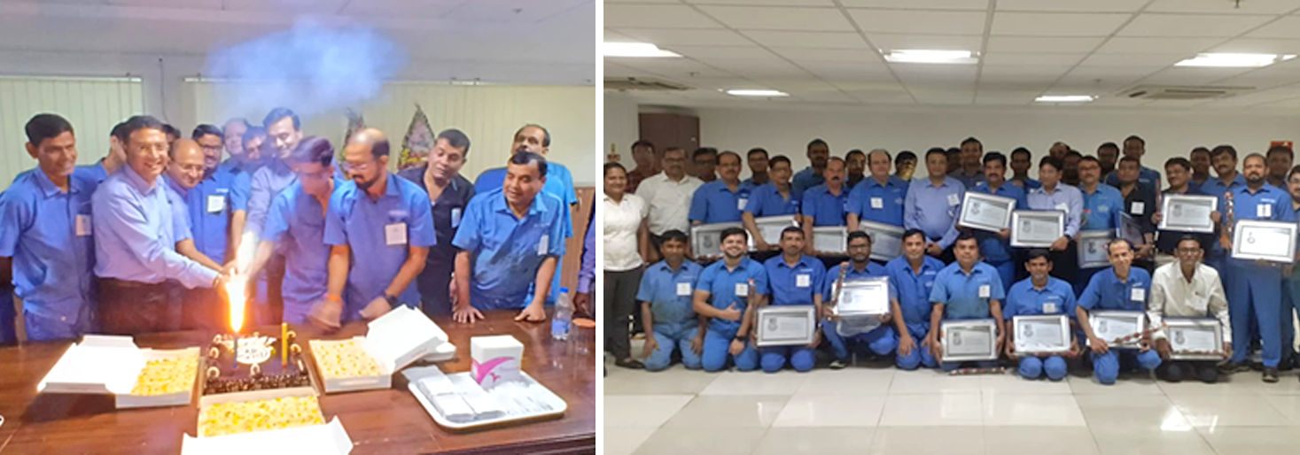
Sahibabad
Total 8 WB employees rewarded
celebration
Long Service Awards for WB Employees
Kolkata
Total 16 WB employees rewarded

Slide 17
MSEDCL Tariff Revision
Summary & Impact

Slide 18
MSEDCL Tariff Revision : Summary
On 21st Jan’25 MSEDCL released a circular for multi year tariff Petition which included the proposed change in tariff rates for the next 5 years
(80 % consumption)
Impact on Newspaper Industry
Rates revision
TOD* Zone |  | 06:00 – 09:00 | 09:00 – 17:00 | 17:00 – 22:00 | 22:00 – 06:00
Change in variable charges : TOD wise
Current | Base rate FY25 | 10.65 | 10.65 | 10.65 | 10.65
 | TOD rates (Rs) | - | 0.80 | 1.10 | (1.50)
 | Total rate/unit | 10.65 | 11.45 | 11.75 | 9.15
Proposed | Base rate FY26 | 10.56 | 10.56 | 10.56 | 10.56
 | TOD rates (Rs) | 1.15 | (2.15) | 1.30 | 1.00
 | Total Rs/unit | 11.71 | 8.41 | 11.86 | 11.56
Impact per Unit (Rs) |  | 1.06 | (3.04) | 0.11 | 2.41
Change in Fixed charges :
Current (Rs/unit) | Rs/unit | 4.40 | 4.40 | 4.40 | 4.40
Proposed (Rs/unit) | Rs/unit | 5.45 | 5.45 | 5.45 | 5.45
Impact per unit |  | 1.05 | 1.05 | 1.05 | 1.05
Total Impact (Rs/Unit) |  | 2.11 | (1.99) | 1.16 | 3.46
Fixed charges
Increase in in billing demand & demand rate
TOD* charges
Revision in TOD zones & TOD rates
* TOD: Time of day
MSEDCL: Maharashtra State Electricity Distribution Company Ltd.

Slide 19
MSEDCL Tariff Revision : Impact & Actions Taken by Plants
Plant Wise Impact of Tariff Hike (Rs L)
Action Taken
Plant | FY 24 | FY 25 Projection | FY 26 Proposed | Total Impact (FY26 Vs FY25) | % Impact (FY26 Vs FY25)
Airoli | 526 | 574 | 673 | 99 | 17%
Pune | 196 | 219 | 252 | 33 | 15%
Nagpur | 43 | 49 | 59 | 10 | 20%
Total | 765 | 842 | 984 | 142 | 17%
Location wise coordination with other newspaper publishers to encourage them to raise objection to MERC* against tariff hike.
Airoli : HT Media & Lokmat media
Pune : Sakal Media & Lokmat media
Nagpur : Sakal Media, Lokmat, Divya Bhaskar and Navbharat
Online objection submitted to MERC by plants & to attend public hearings in respective cities
Airoli : Attended the hearing on 25 Feb
Pune : Attended the hearing on 27 Feb
Nagpur : Attended the hearing on 4 Mar
Verdict expected by 31st March 2025
Pages per kWh and ALP assumed same as FY25
MSEDCL: Maharashtra State Electricity Distribution Company Ltd. | *MERC : Maharashtra Electricity Regulatory Commission

Slide 20
Impact of Utility tariff for FY26
Plant | Ytd Jan FY25 in Rs. Lakhs | FY 25 Proj in Rs. Lakhs | Expected Tarif Hike in % | FY26 Proj in Rs. Lakhs | Var FY26 Vs FY25 proj | Remarks
Sbd | 7,79 | 9,35 |  | 9,35 | -
Knd | 5,62 | 6,75 | -35% | 4,95 | -1,80 | Tarif reduction by Adani power
Air | 4,81 | 5,69 | 17% | 6,67 | 98 | As per Proposed Tariff Hike by MSEDCL
Ban | 3,03 | 3,63 |  | 3,63 | -
Kol | 2,34 | 2,81 |  | 2,95 | 14 | 5% hike calculated based on activity hike in 2025-26.
Che | 2,32 | 2,79 | 5% | 2,88 | 9 | Expected 5% hike from July'25
Pun | 1,86 | 2,24 | 15% | 2,58 | 34 | As per Proposed Tariff Hike by MSEDCL
Msr | 1,16 | 1,39 |  | 1,41 | 1 | Solar Derating impact 1% = 1.39
Hyd | 87 | 1,04 |  | 1,04 | -
Luc | 73 | 88 |  | 88 | -
Ahm | 65 | 78 | 5% | 82 | 4
Nag | 40 | 48 | 20% | 57 | 10 | As per Proposed Tariff Hike by MSEDCL
Bar | 20 | 23 | 5% | 24 | 1 | considered 5% hike here
Total | 31,78 | 38,06 | -0.2% | 37,98 | -9

Slide 21
Electronic Upgradation Status

Slide 22
Press : Electronic Upgradation Status _{Feb 25}
Location | Machine | Age | FY18 | FY19 | FY20 | FY21 | FY22 | FY23 | FY24 | FY25 | FY26 | FY27 | FY28 |  | CapEx
Sbd | Geoman-B | 21
Blr | Regioman-A | 18
Knd | Colorman-B | 18
Knd | Colorman-C | 18
Sbd | Colorman-C | 16
Sbd | Colorman-D | 15
Air | Colorman-B | 16
Kol | Regioman-A | 13
Air | Colorman-A | 16
EAE Project value and payments
(In Rs Cr, Incl taxes)
Machines | Geo B : Sbd Reg A : Blr | Col B : Knd Col C : Sbd | Col C : Knd Col D : Sbd | Col B : Air Reg : Kol | Total
Amt paid | 43 | 37 | 14 | 3 | 97
Amt pending | - | 22 | 43 | 52 | 117
Total | 43 | 59 | 57 | 55 | 215
Airoli Col A approved amount : Rs 52 Cr
Status
Schedule

Slide 23
Press : Electronics Upgrade in progress
Sl | Plant | 2025 | 2022 |  | 2023 |  |  |  |  |  |  |  |  | 2026
 |  | Jan | Feb | Mar | Apr | May | Jun | Jul | Aug | Sep | Oct | Nov | Dec | Jan | Feb | Mar | Apr | May | Jun | Jul | Aug | Sep | Oct | Nov | Dec
1 | KND - Col C
2 | SBD - Col C
3 | SBD - Col D
4 | KOL - Reg
5 | AIR - Col
Status
In Progress
Scheduled timeline

Slide 24
OSP Monthly Summary Report

Slide 25
OSP : General Print Quality & PO _{Feb 25}
General Print Quality (Avg per Month) | Location Wise Trend (Last 6 Months)
OSP : Locations & Performances
Top 6 locations of Category A (PO >20k)
# | Location | Print Partner | Cat. | Print Order (Avg. In Lakh) |  |  |  |  | Print Waste | Trend setters | Quality
 |  |  |  | TOI | ET | MT | NIE | Total
1 | Kochi | Mathrubhumi | A (PO > 20k) | 0.16 | 0.05 | - | - | 0.21 | 7% | 59 | 82%
2 | Patna | Dainik Jagran |  | 0.29 | 0.03 | - | - | 0.32 | 5% | 98 | 83%
3 | Jaipur | DB Corp |  | 0.48 | 0.07 | - | - | 0.55 | 4% | 102 | 75%
4 | Chandigarh | PDPL |  | 0.54 | 0.14 | - | 0.07 | 0.74 | 2% | 173 | 78%
5 | Bhubaneswar | Vibha Pub |  | 0.37 | 0.05 | - | - | 0.42 | 2% | 123 | 82%
6 | Coimbatore | Colour Graphics |  | 0.25 | - | - | 0.08 | 0.34 | 4% | 45 | 76%
7 | Indore | Nai Duniya |  | 0.16 | 0.05 | - | - | 0.21 | 5% | 80 | 74%
8 | Ranchi | Dainik Jagran |  | 0.19 | 0.03 | - | - | 0.23 | 4% | 72 | 78%
9 | Aurangabad | Lokmath | B (PO 10k – 20k) | 0.07 | - | 0.05 | - | 0.12 | 17% | 59 | 74%
10 | Madurai | Dinamalar |  | 0.13 | - | - | - | 0.12 | 13% | 38 | 75%
11 | Dehradun | Dainik Jagran |  | 0.15 | - | - | - | 0.15 | 6% | 47 | 75%
12 | Goa | Elegant Printers |  | 0.16 | 0.03 | - | - | 0.19 | 7% | 54 | 71%
13 | Vijayawada | Jagathi Pub. |  | 0.10 | - | - | - | 0.10 | 5% | 52 | 82%
14 | Raipur | DB Corp |  | 0.13 | - | - | - | 0.13 | 7% | 33 | 72%
15 | Vizag | Jagathi Pub. |  | 0.14 | - | - | - | 0.14 | 5% | 54 | 75%
16 | Bhopal | Nai Duniya |  | 0.19 | - | - | - | 0.19 | 3% | 39 | 74%
17 | Bareilly | Dainik Jagran |  | 0.09 | - | - | - | 0.09 | 5% | 83 | 74%
18 | Guwahati | Anubhuti Printers |  | 0.11 | - | - | - | 0.11 | 10% | 34 | 72%
19 | Kolhapur | Elegant Printers | C (PO < 10k) | 0.05 | - | - | - | 0.05 | 19% | 37 | 71%
20 | Mangalore | MMCL |  | 0.10 | - | - | - | 0.10 | 7% | 36 | 75%
21 | Mysore | MMCL |  | 0.11 | - | - | - | 0.11 | 7% | 33 | 75%
22 | Hubli | MMCL |  | 0.08 | - | - |  | 0.08 | 5% | 32 | 74%
23 | Siliguri | Darpan Times |  | 0.05 | - | - | - | 0.05 | 12% | 28 | 74%
24 | Gwalior | Bhaskar |  | 0.04 | - | - |  | 0.04 | 9% | 22 | 69%
25 | Jabalpur | Dainik Jagran |  | 0.04 | - |  | - | 0.04 | 14% | 22 | 68%
26 | Jammu | Dainik Jagran |  | 0.04 | - | - | - | 0.04 | 10% | 46 | 69%
Total |  |  |  | 4.22 | 0.46 | 0.05 | 0.15 | 4.88 |  | 1,516
Data source : Production MIS

Slide 26
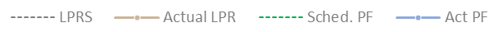
OSP - Category A : TOI LPR & Print Finish _{Feb 25}
1.1Bri
Bhubaneswar (LPRS - 00:00, Sched. | PF – 03:00)
Coimbatore (LPRS - 01:00, Sched. PF – 03:30)
Highlights
Avg PO : 0.37 L | Avg LPR : 00:21 | Avg PF : 02:01
Avg PO : 0.25 L | Avg LPR : 01:08| Avg PF : 03:05
On Budget Day, ET printing increased by nearly 157% compared to normal days, with a total of 5.18 lakh copies of TOI and ET printed across all 26 OSP locations. Print completion compliance was achieved at 100%, while NP consumption saw an 85% increase on Budget Day.
The Big Basket Storyteller innovation was successfully executed for the first time with standard SNP, contributing to revenue generation across most OSP locations. Despite initial readiness and technical challenges at certain OSP locations, the innovation was successfully delivered.
Madurai continues to face issues related to spare obsolescence and difficulties in handling editions with more than 20 pages.
Patna (LPRS - 00:00, Sched. PF – 02:00)
Kochi (LPRS – 00:00, Sched. PF – 02:30)
Avg PO : 0.29 L | | Avg LPR : 23:58 | Avg PF : 01:17
Avg PO : 0.16 L | Avg LPR : 00:54 | Avg PF : 02:06
Chandigarh (LPRS – 01:00, Sched. PF –04:00)
Jaipur (LPRS - 00:45, Sched. PF – 04:00)
Avg PO : 0.54 L | Avg LPR : 01:16 | Avg PF : 03:30
Avg PO : 0.48 L | Avg LPR : 01:08 | Avg PF : 02:55
Considered only TOI main editions
Data source : Pi4.O

Slide 27
OSP Press Details & Print Order: Category ‘A*’ Centres _{Feb 25}
Location | Print Partner | Press | Configuration | Qty | Age (yrs) | Max Pagination | Col/ BW | Print Order (copies in Lakh as on Feb 25) |  |  | Print Order (copies in Lakh As on Sep’24) | Print Order (copies in Lakh As on 1st Sep’23)
 |  |  |  |  |  | Max Pagination |  | TOI | ET | MT | NIE | All edition
Bhubaneswar | Vibha | Cityline |  | 1 | 12 | 24 | 20/4 | 0.37 | 0.05 |  |  | 0.42
Chandigarh (BCCL infra) | Prithvi Digital | Hiline |  | 1 | 25 | 24 | 16/8 | 0.54 | 0.14 | - | 0.09 | 0.77
Coimbatore | Color Graphics | Cityline |  | 1 | 21 | 24 | 24 | 0.25 | - | - | 0.08 | 0.33
Indore | Nai Duniya | Cityline |  | 1 | 10 | 24 | 24 | 0.16 | 0.05 |  | - | 0.21
Jaipur | Dainik Bhaskar | Hiline |  | 1 | 18 | 24 | 24 | 0.50 | 0.07 | - | - | 0.57
Kochi (BCCL infra) | Mathrubhumi | Hiline |  | 1 | 18 | 24 | 24 | 0.16 | 0.06 | - | - | 0.22
Patna | Dainik Jagran | Cityline |  | 1 | 12 | 28 | 28 | 0.29 | 0.03 | - | - | 0.32
Ranchi | Dainik Jagran | Cityline |  | 1 | 14 | 24 | 24 | 0.18 | 0.04 | - | - | 0.22
*Category ‘A’ PO more than 20,000
Folder + Standard Former
Balloon Former
Normal Tower
Mono Unit
Reel stand
Y Unit
Ageing (DW) >
15-21 yrs,
0-14 yrs
Data source : Respective Osp’s & Production MIS

Slide 28
OSP Press Details & Print Order: Category ‘B*’ Centres _{Feb -25}
Location | Print Partner | Press | Configuration | Qty | Age (yrs) | Max Pagination | Col/ BW | Print Order (copies in Lakh as on Feb 25) |  |  | Print Order (copies in Lakh As on Sep’24) | Print Order (copies in Lakh As on 1st Sep’23)
 |  |  |  |  |  | Max Pagination |  | TOI | ET | MT | NIE | All edition
Aurangabad | Lokmat | Hiline |  | 1 | 17 | 20 | 18/2 | 0.08 | - | 0.05 | - | 0.13
Bhopal | Nai Dunia | Sigmarq |  | 1 | 8 | 24 | 24 | 0.19 | - | - | - | 0.19
Dehradun | Dainik Jagran | Cityline |  | 1 | 19 | 28 | 28 | 0.16 | - | - | - | 0.16
Goa | Elegant | Hybrid |  | 1 | 16 | 24 | 16/8 | 0.15 | 0.03 | - | - | 0.18
Guwahati | Janambhoomi | M360 |  | 1 | 11 | 16 | 16 | 0.12 | - | - | - | 0.12
Madurai | Dinamalar | Frontline |  | 1 |  | 24 | 16/8 | 0.13 | - | - | - | 0.13
Mysore | MMCL | Ecoline |  | 1 | 1 | 20 | 20 | 0.11 | - | - | - | 0.11
Raipur | Dainik Bhaskar | Orient Excel |  | 1 | 17 | 24 | 24 | 0.13 | - | - | - | 0.13
Vizag | Sakshi | Cityline |  | 1 | 16 | 20 | 20 | 0.14 | - | - | - | 0.14
Folder + Standard Former
Balloon Former
Normal Tower
Mono Unit
Reel stand
Y Unit
Ageing (DW) >
15-21 yrs,
0-14 yrs
Data source : Respective Osp’s & Production MIS
Category ‘B’ PO between 10,000 to 20,000

Slide 29
OSP Press Details & Print Order : Category ‘C*’ Centres _{Feb -25}
Location | Print Partner | Press | Configuration | Qty | Age (yrs) | Max Pagination | Col/ BW | Print Order (copies in Lakh as on Feb 25) |  |  | Print Order (copies in Lakh As on Sep’24) | Print Order (copies in Lakh As on 1st Sep’23)
 |  |  |  |  |  | Max Pagination |  | TOI | ET | MT | NIE | All edition
Bareilly | Dainik Jagran | Cityline 1 |  | 1 | 13 | 24 | 24 | 0.09 | - | - | - | 0.09
 |  | Cityline 2 |  | 1 | 15 | 24 | 24
Gwalior | Dainik Bhaskar | Orient |  | 1 | 15 | 24 | 24 | 0.04 | - | - | - | 0.04
Hubli | MMCL | Cityline |  | 1 | 9 | 20 | 20 | 0.08 | - | - | - | 0.08
Jabalpur | Nai Duniya | Orient |  | 1 | 15 | 24 | 24 | 0.04 | - | - | - | 0.04
Jammu | Dainik Jagran | Orient |  | 1 | 20 | 24 | 16/8 | 0.04 | - | - | - | 0.04
Kolhapur | Elegant | Hybrid |  | 1 | 12 | 24 | 20/4 | 0.05 | - | - | - | 0.05
Mangalore | MMCL | Cityline |  | 1 | 9 | 20 | 20 | 0.09 | - | - | - | 0.09
Siliguri | Darpan | Roland |  | 1 | 12 | 20 | 20 | 0.04 | - | - | - | 0.04
Vijayawada | Sakshi | Cityline |  | 1 | 14 | 20 | 20 | 0.09 | - | - | - | 0.09
Folder + Standard Former
Balloon Former
Normal Tower
Mono Unit
Reel stand
Y Unit
Ageing (DW) >
15-21 yrs,
0-14 yrs
Data source : Respective Osp’s & Production MIS
End of Document
*Category ‘C’ PO less than 10,000

